Slide 1

C Programing Individual Project
By: Thanapoom Tanalakwong (64011667)

Slide 2
Table of Contents
Project Introduction
Pseudo Code
Knowledge used from this class
Libraries used
Main part of the Program
Addition Function
Subtraction Function
Multiplication Function
Root finding Function
Entire Source Code (Can be found on my GitHub repository as well)
Possible Improvements

Slide 3
Project Introduction
The individual project that I chose is “Polynomial Math”
The aim of this project is to be able to add, subtract, multiply, and find the root of the polynomial that the user inputs
Each operation will be a separate function that the user will be able to choose from

Slide 4
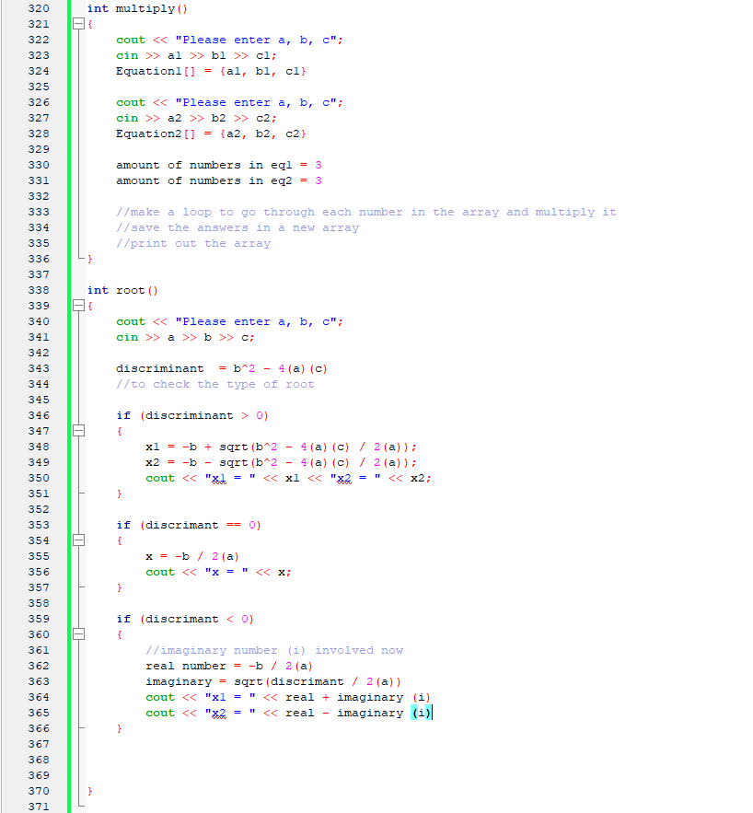
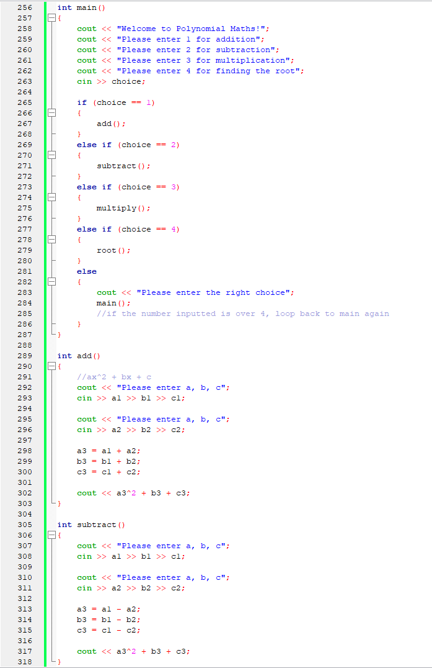
Pseudo Code

Slide 5
Knowledge Used from this Class
Mainly the basics; variable and its types, structures, and function
Also a bit of arrays and pointers for the multiplication part

Slide 6

Libraries Used
Just the basic iostream and cmath (for square root)

Slide 7
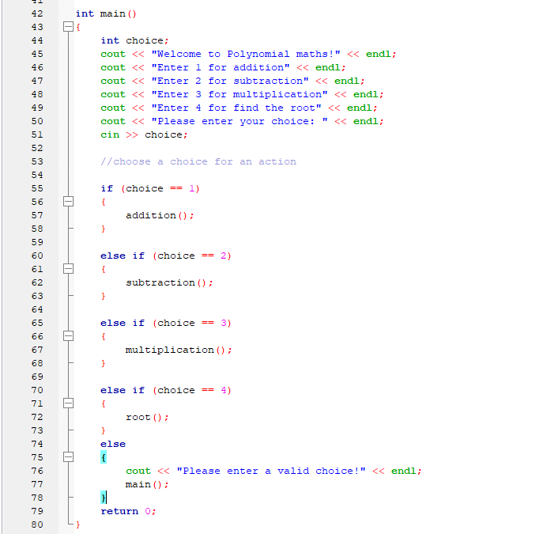
Main
First asks the user to enter their choice and them proceeds to the desired function
If the choice is greater than four, then it will ask the user to enter a valid choice

Slide 8
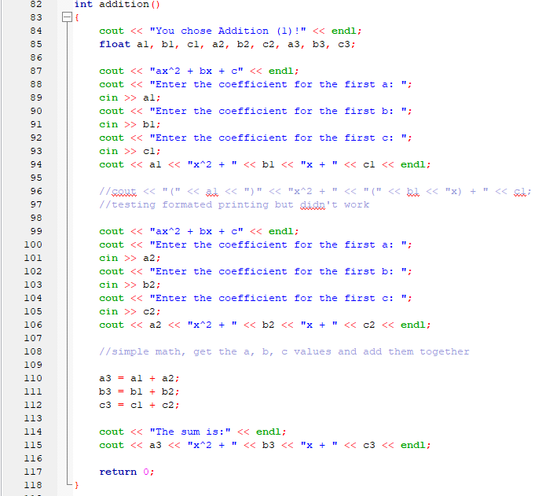
Addition
Asks the user to input the a, b, and c values of each polynomial
Then simply adds them

Slide 9
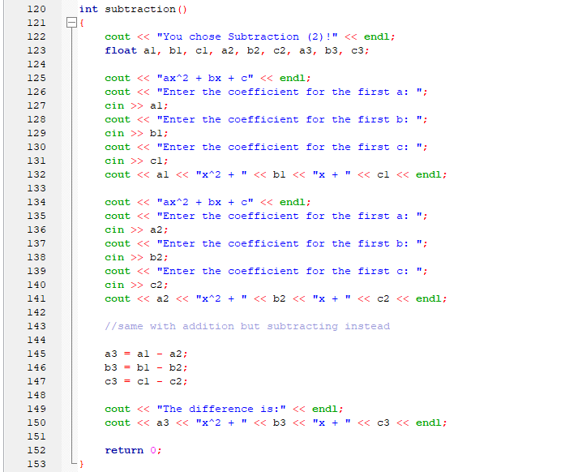
Subtraction
Pretty much the same as the addition for the first part
But then subtracts the values instead then prints out the values

Slide 10
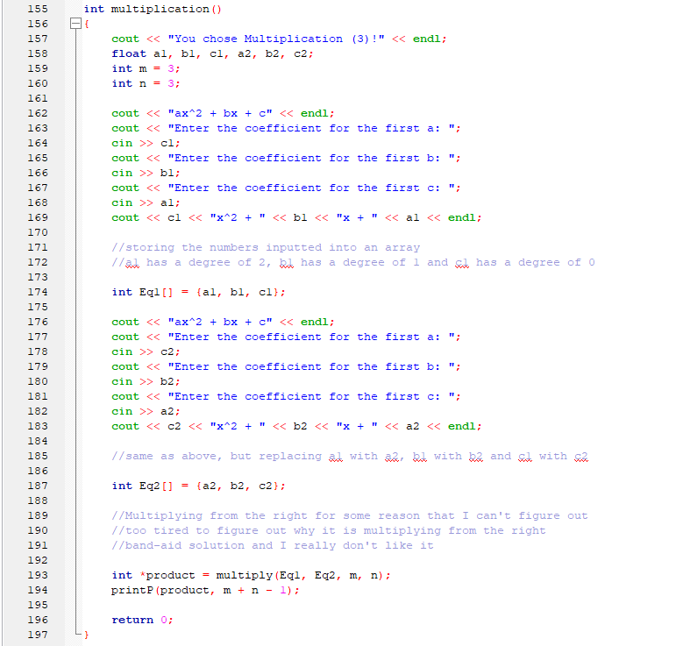
Multiplication
First asks the user for the values of a, b, and c of each polynomial
Then stores each polynomial values into the arrays Eq1 and Eq2
After that it points to the multiply function
Note: n and m are the length of the array
Note 2: I’m not sure why but if I but a first and c last, the value it returns is wrong (might be due to how arrays are stored but I could be wrong), so I just swapped the orders around

Slide 11
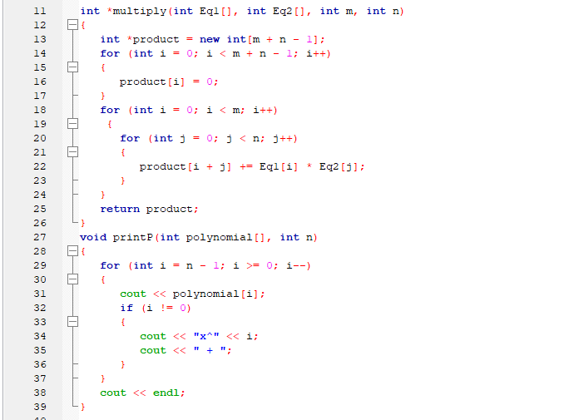
Multiplication
What product does is it goes through the a, b and c values of each array and multiply them together
Then the function will return the product array and is used in the printP function to print out the new polynomial

Slide 12
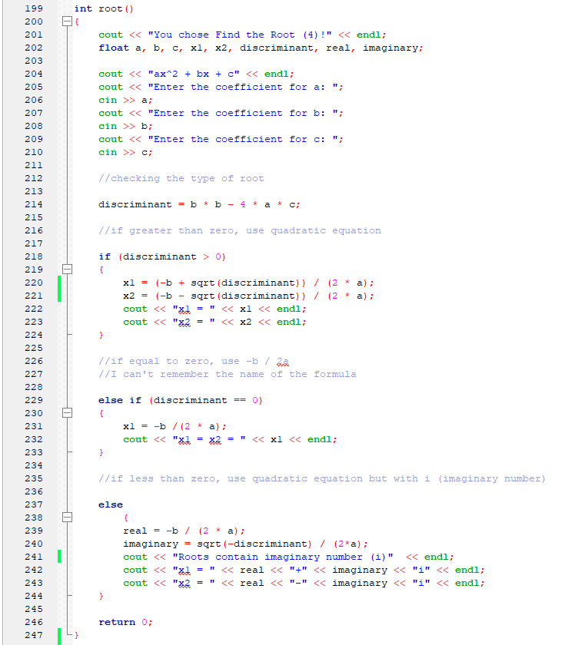
Root
First asks for the user to input the values a, b, c
Then it will use those values to find the discriminant and determine what formula to use to find the root
If the discriminant is greater than 1, it will use the quadratic equation
If it is equal to zero, then it will use the other equation (I completely forgot the name for it)
If it is less than zero, then it will use the quadratic function but it will also have to deal with i

Slide 13
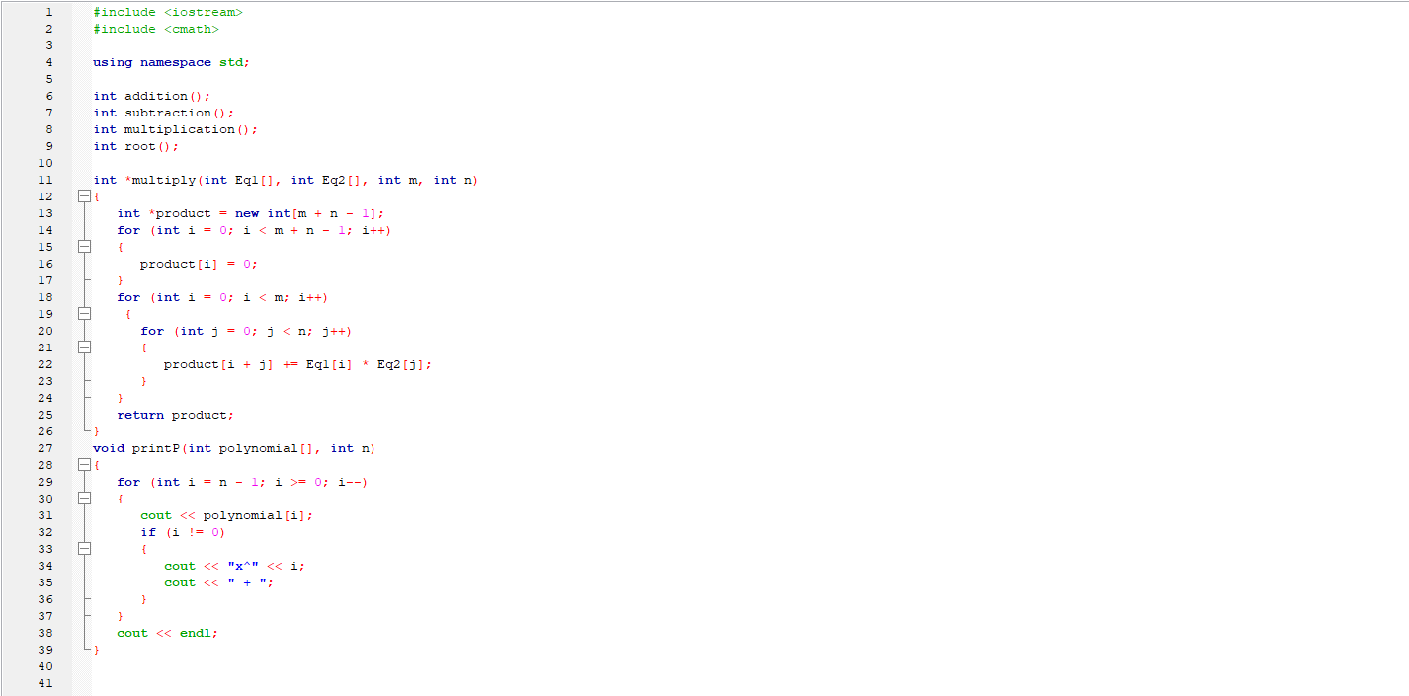
Entire Source Code

Slide 14
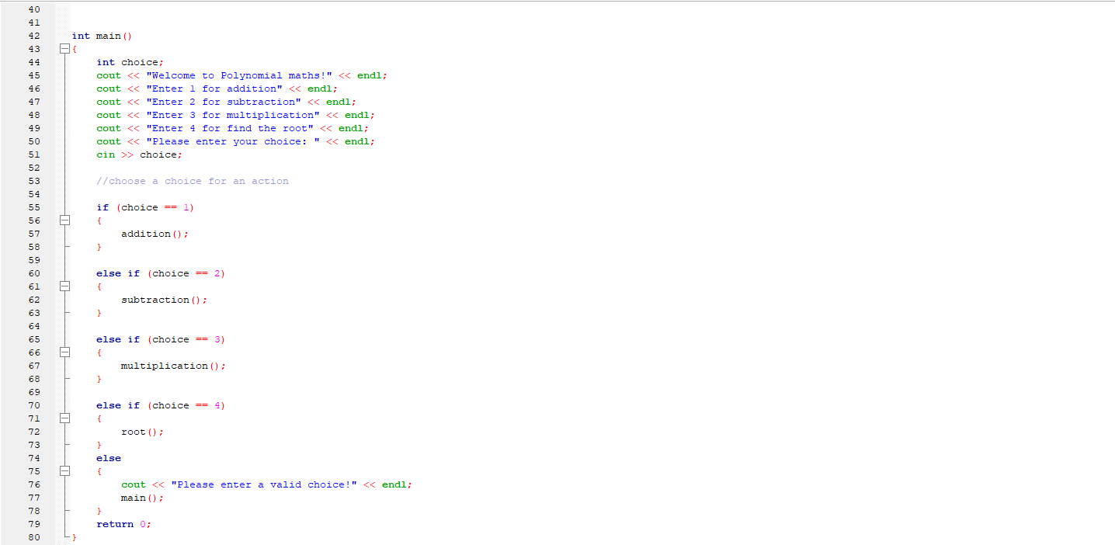
Entire Source Code

Slide 15
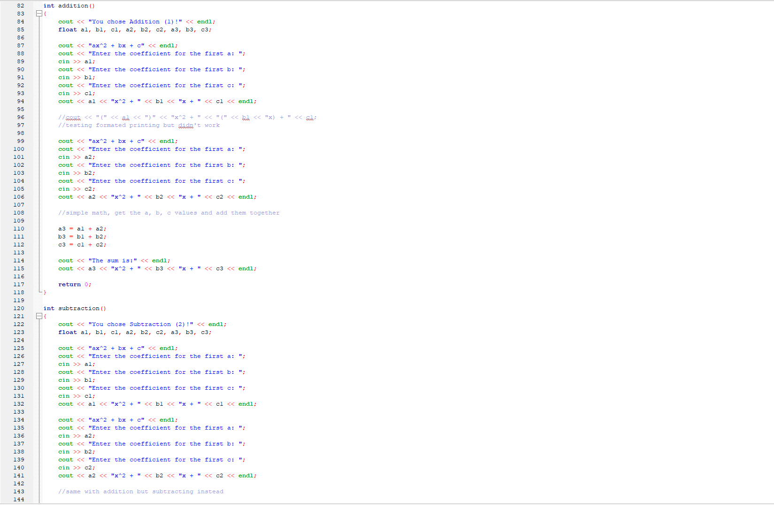
Entire Source Code

Slide 16
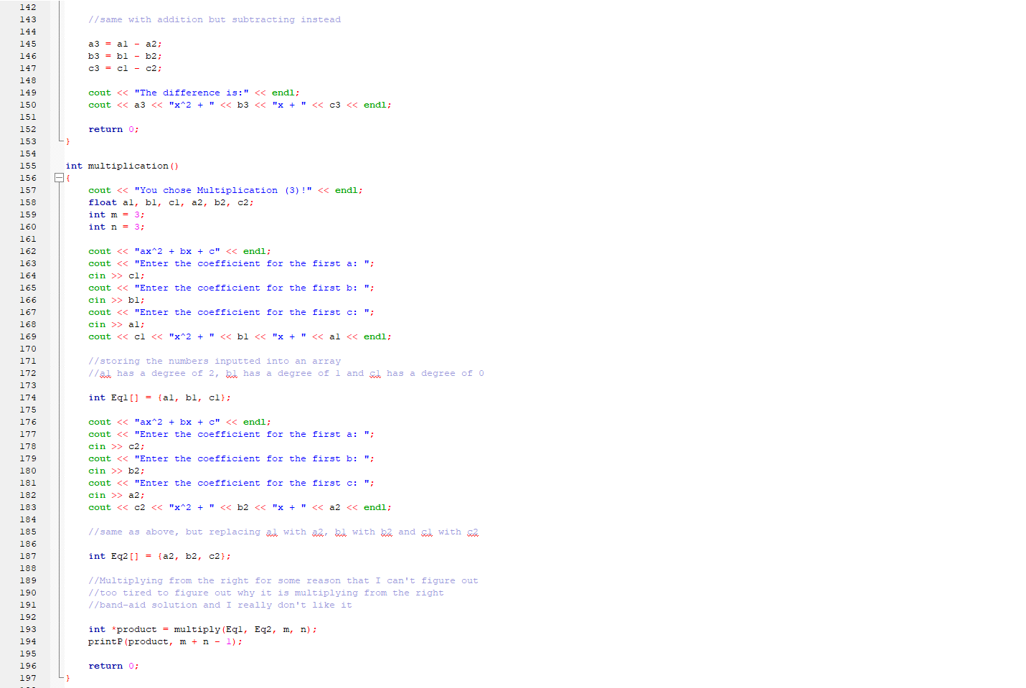
Entire Source Code

Slide 17
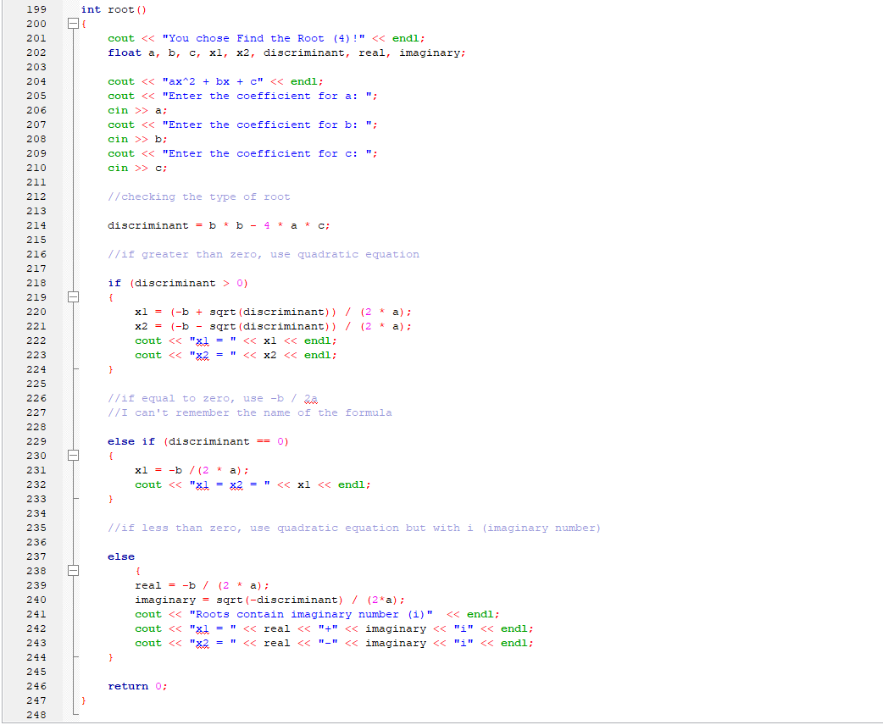
Entire Source Code
Link to my GitHub repository: https://github.com/Edzze/Polynomial-Math

Slide 18
Possible Improvements
The most obvious one is the multiply function to work properly
I could have used arrays to store the numbers for addition, subtraction, and finding the roots and use pointer arithmetic; or maybe use linked lists
I could also include the use of getting inputs from files
I could also try to find a way to store the data dynamically, but I can’t think of an instance to use it

Slide 19
Thank you for listening

